Slide 1
16S rRNA Experimental Design
2016 Metagenomics Course
Dave baker and tom barker
Platforms and Pipelines

Slide 2
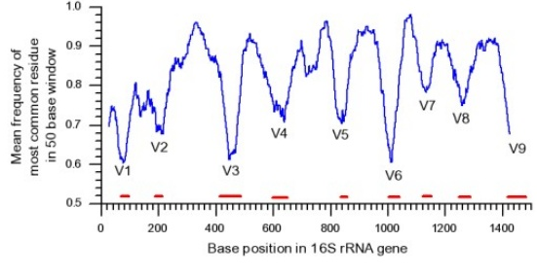
Considerations
Before embarking on an experiment there are many things to consider
Choose your regions(s)
There is no consensus on which subsets to use for community analysis
PCR bias
Community bias
Size… some as large as 2.5kb
(preferential amplification of smaller products)
Cycles
Chimeras
Initial starting template
Normalisation across all samples is important!
Cost
Replicates
Biological
Technical
If time and costs permit do a small pilot or trial using several different strategies looking at different variable regions
Depending on the community being studied and the hypotheses posed, different target regions and multiplexing strategies can be employed.

Slide 3
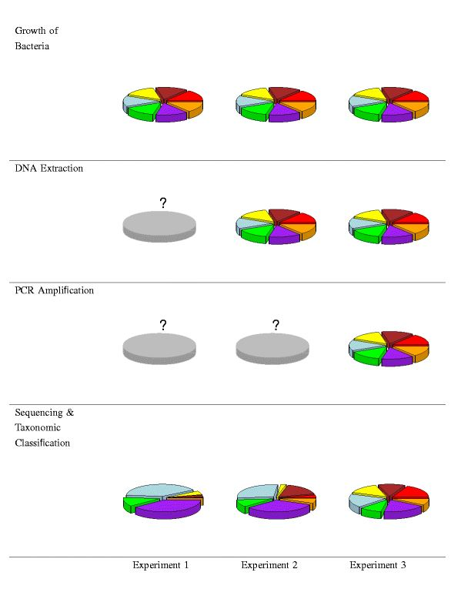
Bias
7 species
1 Mock pooling of cells
2 Mock pooling of gDNA
3 Mock pooling of PCR
1
2
3
Bias
The observed community composition can be a severe distortion of the quantities of bacteria actually present in the microbiome, hampering analysis and threatening the validity of conclusions from metagenomic studies.
Bias
Bias
=
Brooks et al 2015

Slide 4
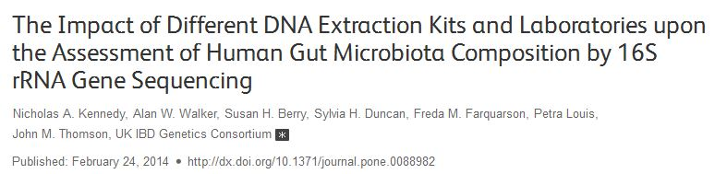
DNA Extraction Kit
Conclusions
This study demonstrates important differences in the yield and relative abundance of key bacterial families for kits used to isolate bacterial DNA from stool. This highlights the importance of ensuring that all samples to be analyzed together are prepared with the same DNA extraction method, and the need for caution when comparing studies that have used different methods

Slide 5
Choosing your platform
 | Type | Reads per run | Size | Common regions | Comments
Roche 454 | Standard PCR | Up to 1 million | 400-700 bp | V1-V3 | No longer supported and expensive
Illumina | Standard PCR | 25 000 000/ Miseq PE300/250 | 300-500 bp | V1-V3, V3-V4, V4, V4-5 | Tom to go into more detail
Illumina | Nextera | 25 000 000/ Miseq PE300/250 | 300-500 bp | V1-V3, V3-V4, V4, V4-5 | Tom to go into more detail
PacBio | PCR (1.5 kb) | 75 000/cell | 1.5 kb | Entire region and less | Next slides…
Minion | Barcoded (12) PCR | 50 000 | 1.5 kb | Entire region | Not reproducible good for quick assessment

Slide 6
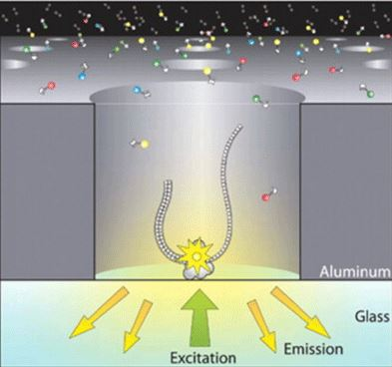
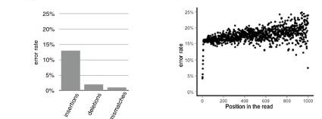
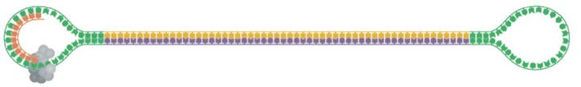
PacBio
Single Molecule Real Time Sequencing
Average amplicon polymerase reads around 15kb and increasing
15% raw error rate

Slide 7
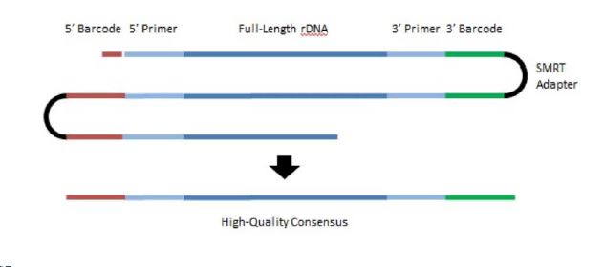
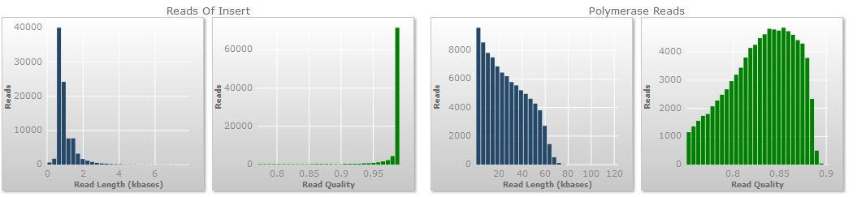
Circular Consensus Sequence (CCS) Reads
Based on 33% loading of 150 000 well/ZMW’s
CCS Accuracy | Full Length 16S reads per cell
90.0 % | 50 000
99.0 % | 25 000
99.9% | 10 000
92 000 reads 2.5 Gbp raw data average read length of 27.4kb

Slide 8
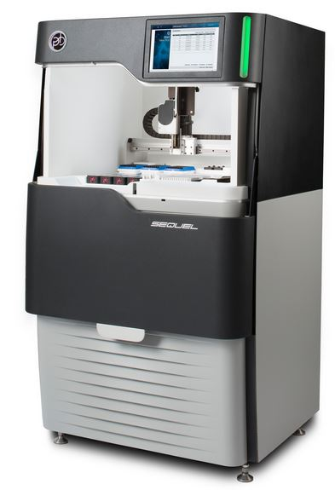
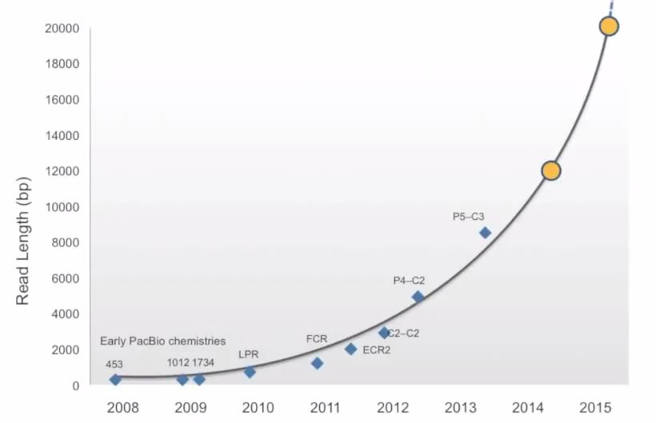
PacBio
384 barcodes with symmetric barcodes and a potential 73 536 using asymmetric barcodes (16 bp)
Although cost per base higher than Illumina, supplementing databases with full-length 16S sequences continues to be important especially in generating niche specific databases
Significant increases in several orders of taxa from FL PacBio data compared to short read Illumina data
Better taxonomic resolution
Less ambiguous classification
New Sequel platform increasing reads from one cell by 7X
New Sequel cells scalable…
Currently 1 million ZMW’s
Going up to 5 million in 2017
P7-C5 ???
Read length Improvement
P6-C4

Slide 9
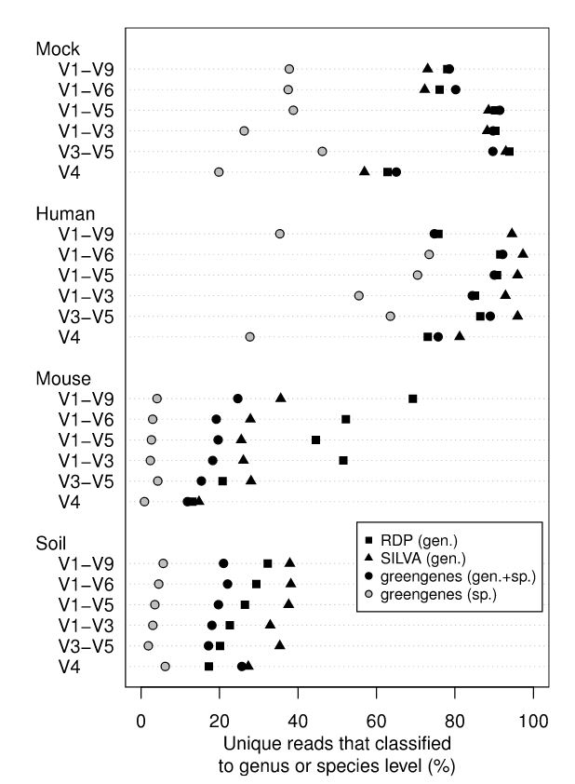
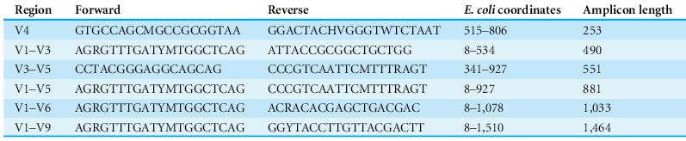
PacBio Primer Design Considerations
The ability to classify sequences to genus or species level is a function of
Read length
Sample type
Reference database

Slide 10
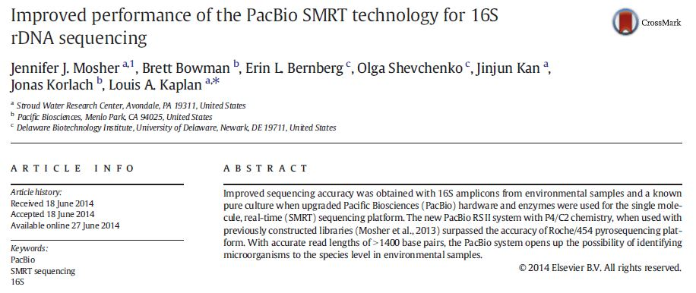
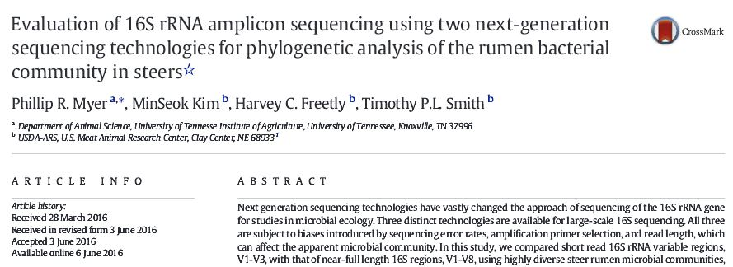
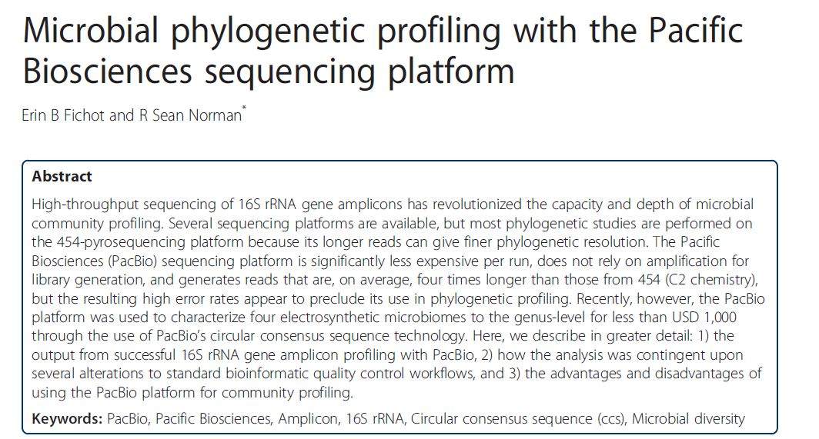
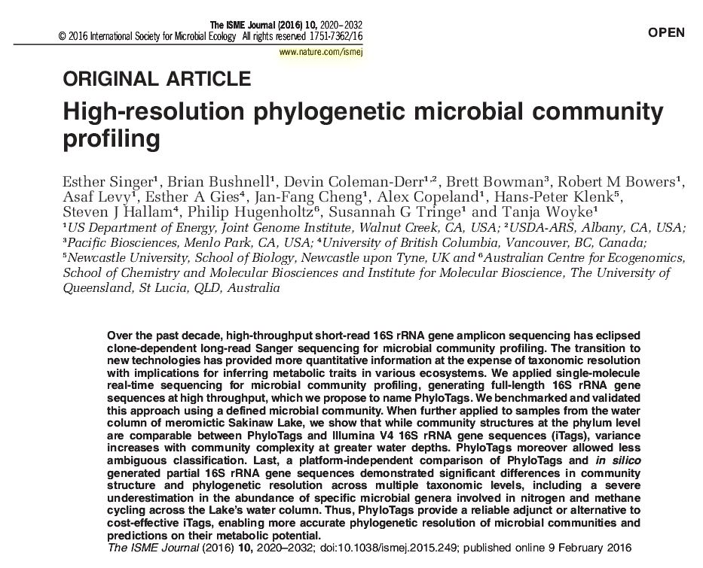
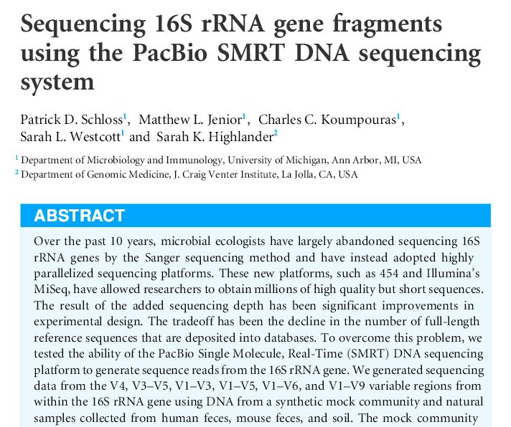
PacBio Further reading
Notes:
Because of the recent technologies focucussing on particular regions increased readlengths increase the accuracy and sensitivity of classificaction against databases

Slide 11
Illumina’s Two PCR Protocol
TruSeq Adapter Overhang
16S V4
1st PCR
Highly Conserved Region
Hypervariable Region 4
Highly Conserved Region
16S V4
TruSeq Adapter Overhang
2nd PCR
TruSeq Adapter Overhang
16S V4
Amplicon
Library
P5
i5
i7
P7
16S V4
TruSeq Adapter Overhang
Pros
Only need to design a primer set for your region of interest.
Use the same indexed primers for any region of interest.
You can use Illumina’s Nextera XT Index kits for second PCR
Cons
Requires two PCRs and clean-ups making it more expensive.
Sequencing through the region of interest primer loses ~20bp of sequencing from each read.

Slide 12
Kozich et al Dual Index Strategy
P5
i5
16S V4
Single PCR
Pad
Highly Conserved Region
Hypervariable Region 4
Highly Conserved Region
Pad
i7
16S V4
P7
Pad
16S V4
Amplicon
Library
P5
i5
i7
P7
16S V4
Pad
Pros
Single PCR and clean-up making it cheaper than the two PCR approach.
Uses custom sequencing primers so you don’t have to sequence through the region of interest primer.
Cons
All primers are specific to the region of interest so a whole new set of primers needs to be ordered for each different region.
Custom sequencing primers are required.

Slide 13
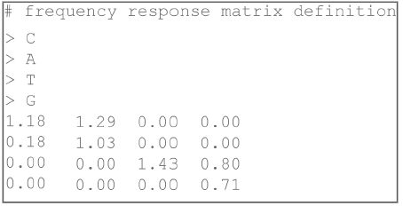
Phasing, Pre-Phasing, and Colour Matrix
Empirical phasing correction algorithm
Old versions of MCS/ HCS calculated phasing and pre-phasing corrections for the first 12 cycles and applied this value to the rest of the run.
Current versions of software optimise phasing and pre-phasing correction for every cycle.
Cross Talk Matrix
There are two lasers that excite four dyes, one for each base.
The emission spectra of the four dyes overlap slightly.
Frequency cross-talk needs to be deconvolved using a frequency cross talk calibration
Older versions of MCS/ HCS used the first 4 cycles but newer versions use 11 improving estimations for low diversity samples.

Slide 14
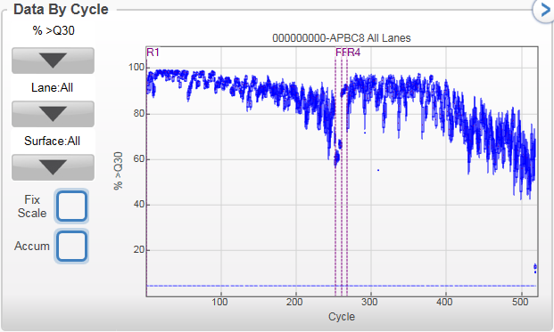
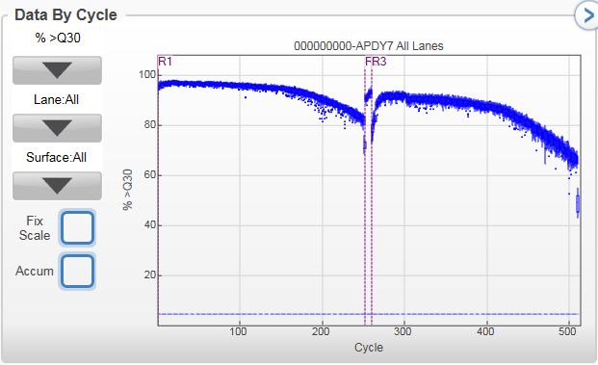
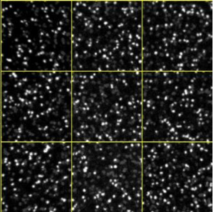
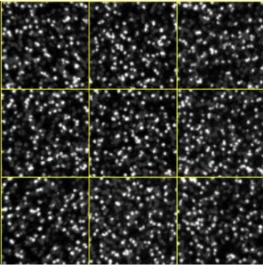
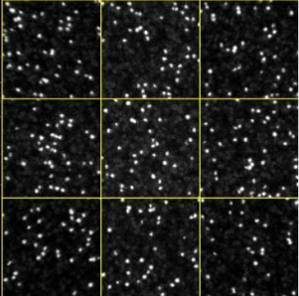
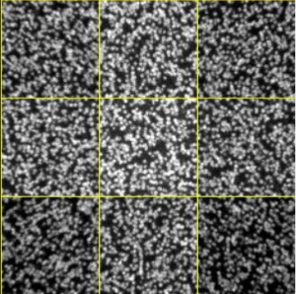
Sequencing Low Diversity Libraries
>=Q30
6.0 GB
85.5%
25.45%
PhiX
>=Q30
10.1 GB
89.2%
1.72%
PhiX
Data once PhiX is removed = 10.03 M Reads (4.5 GB)
Data once PhiX is removed = 21.73 M Reads
(9.9 GB)
A
C
Same sequence for first 5 cycles so multiple clusters are called as one.
Sequence diverges at later cycles and clusters do not pass filter.
G
T

Slide 15
Spacers, Molecular Barcodes, and Chimeras
Illumina Sequencing Primer
Illumina Sequencing Primer
Wu et al 2015
Spacer
(0-7bp)
P5
Index
P7
Spacers
Molecular Barcodes
Two step PCR method reduces PCR biases caused by long barcoded primers.
Spacers on each end totalling 7bp shift sequencing phases increasing sequence diversity.
Single 12bp index.
Average 10% more bases >Q30
~15% more raw reads.
Randomers used to distinguish PCR duplicates from unique template molecules.
Can be used to identify sequencing errors or true variation.
Chimeras
Amount of template DNA and PCR cycles should be optimised to reduce formation of chimeras.
Too much DNA or too many cycles PCR can increase occurrence of chimeras.
Use of a polymerase with high processivity has been shown to reduce chimera formation.

Slide 16
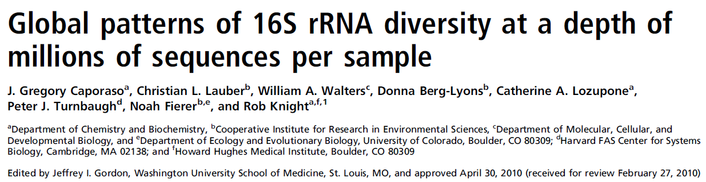
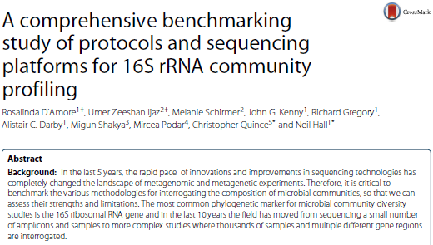
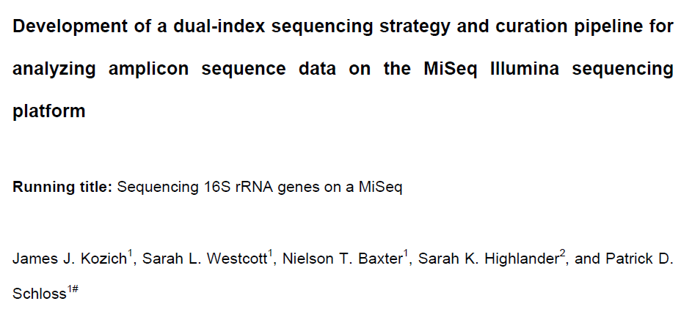
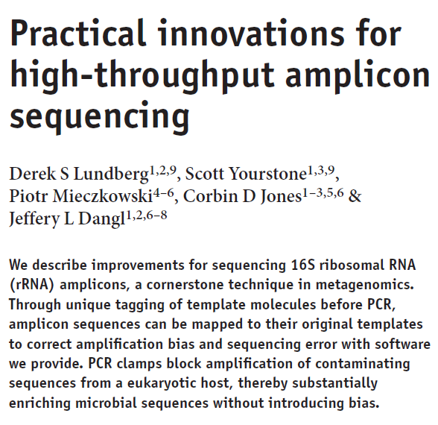
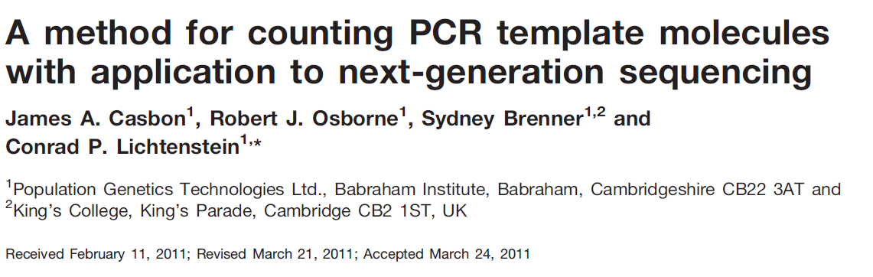
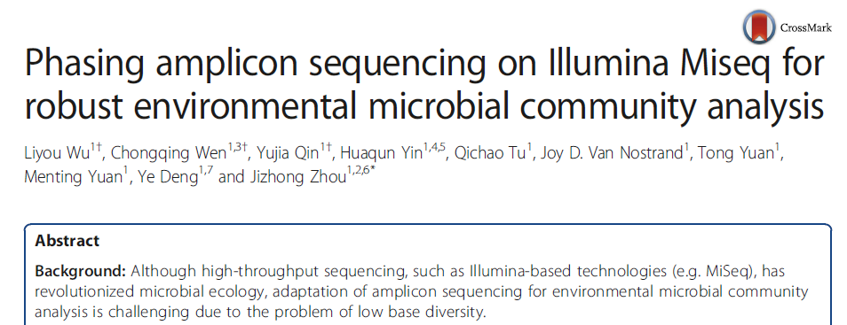
Further Reading

